Slide 1
OUR WORKING DEFINITION OF LITERATURE:
http://engl278w.wordpress.com/2008/12/04/literature-definitions/
“Literature is writing that is considered by both critics and consumers to be of a high quality and cultural value, in which the creative use of language is prominent.”

Slide 2
WORLD LITERATURE
God is a global God.
He has always cared about the entire world.
"God so loved the world...." (John 3:16) From the beginning He has wanted family members from every nation He created.
The Bible says, "From one person God made all nations who live on earth, and he decided when and where every nation would be." (Acts 17:26)

Slide 3
WORLD LITERATURE
God is a global God.
He has always cared about the entire world.
We're more connected than we realize and God can use that connectedness as a means for us to fulfill his Great Commission. Jesus gave us a pattern for such involvement:
"... You will tell everyone about me in Jerusalem, in all Judea, in Samaria, and everywhere in the world."
(Acts 1:8)

Slide 4
SIGNIFICANT HUMAN EXPERIENCES
WORLD LITERATURE
is important to you and me because we all share
“Everything that happens to you is significant, and it’s an experience that happened to someone else, in one form or another.”
(Fr. Joseph Galdon, S.J.)

Slide 5
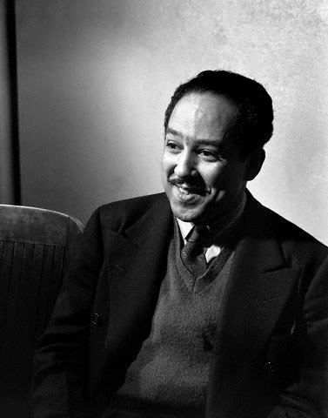
Example:
Well, son, I'll tell you: Life for me ain't been no crystal stair. It's had tacks in it, And splinters, And boards torn up, And places with no carpet on the floor— Bare. But all the time I'se been a-climbin' on, And reachin' landin's, And turnin' corners, And sometimes goin' in the dark Where there ain't been no light. So, boy, don't you turn back. Don't you set down on the steps. 'Cause you finds it's kinder hard. Don't you fall now— For I'se still goin', honey, I'se still climbin', And life for me ain't been no crystal stair.
“Mother To Son”
by Langston Hughes

Slide 6
ESSAY QUIZ 1: My advice to my future son or daughter Format: 2 paragraphs, title Scoring: Content 4pts. Organization 3pts Grammar, Spelling, Penmanship 3pts

Slide 7
PERFORMANCE TASK 1:
ROUND-TABLE DISCUSSIONS
(RTD, 1st quarter)
Form 7 groups, 1 for each geographical division.
Each group or round table will have only 45 minutes to go through the process of discussing the selected literary work.
Discuss the work from the spotlighted country based on prior knowledge (what they learned in other classes, in their own reading, etc.),geographical and cultural significance (Go Google Maps!) and “Significant Human Experience”. Discuss figurative language, imagery and poetic devices for poetry, and narrative devices for fiction. At least 5 vocabulary words must also be discussed.
Roles are as follows:
(1) Moderator: introduces RDT members, the topic for discussion; facilitates the discussion to ensure maximum participation;
(2) Lead Discussants: Summarizes the work, points out important parts, explains the theme, relates personal connection to the work;
(3) Reactors: ask questions, concurs with or disagrees with points of lead discussants
5. Rubrics

Slide 8
PERFORMANCE TASK 2:
WORLD LIT WALL COLLAGE
(Same RTD groups, 1st quarter)
Each group researches on the other countries within their geographical division. Choose two authors from two different countries.
The group looks for works from these authors with a common theme, topic, or significant experience.
The group creates a collage of the ideas, themes, and experiences presented in these works.
All materials in the collage should be recycled.
The collages will be installed on walls in designated areas around the campus.

Slide 9
PERFORMANCE TASK 3:
MySHE Blog
(Individual,long-term)
Your teacher will create a general blog account from which each student will create a personal blog site or online diary.
2. Contents of the blog:
Everything you’ve read, learned, and felt, and the answer to the essential questions.
3. Required blog entries per quarter: 2 (mid-quarter, pre-end of quarter)

